Slide 1
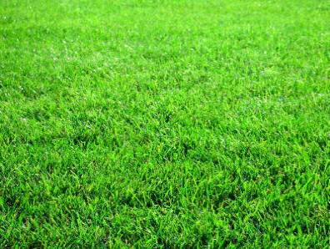
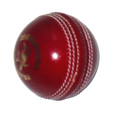
Bowl-out

Slide 2
Bowl-out Instructions
Start the slideshow and go onto slide 3
Have two teams – A and B
Ask any questions you like alternatively to each team – if they get a question correct they can click one of their balls to attempt to hit the stumps
This continues until a team gets 2 hits of the stumps
The balls disappear if you click the number underneath he ball

Slide 3
1
2
3
4
1
2
3
4

